Slide 1

BITCOIN: CURRENCY OF THE FUTURE?
Michelle Vergara
Ranjini Thaver
GLOBAL CONFERENCE ON BUSINESS AND FINANCE, COSTA RICA, 2016

Slide 2

What is a Bitcoin?
“…a purely peer-to-peer form of electronic cash”
-Satoshi Nakamoto (pseudonym)

Slide 3
What is a Bitcoin?
Nakamoto (2008) fulfills the need for a trust-based currency
Uses hash-based proof-of-work and digital signatures to guarantee the value and acceptance of the currency.
Does not require a third-party institution as mediator between two parties.
No transaction fees

Slide 4
Supply of Bitcoin
Bitcoins are generated by miners who expend CPU time and electricity to put them into circulation.
It is capped at 21 million Bitcoins
coins introduced into the current supply is decreased by 50% every 4 years(Kroll, Davey & Felten, 2013, p. 5).

Slide 5
Supply of Bitcoin
Start (2009) : 7200.00000000 #start
Halving 1 (2012) : 3600.00000000 #Halving was November 2012
Halving 2 (2016) : 1800.00000000
Halving 3 (2020) : 900.00000000
Halving 4 (2024) : 450.00000000
Halving 5 (2028) : 225.00000000
Halving 6 (2032) : 112.50000000
Halving 7 (2036) : 56.25000000
Halving 8 (2040) : 28.12500000
Halving 9 (2044) : 14.06250000
Halving 10 (2048) : 7.03125000
Halving 11 (2052) : 3.51562500
Halving 12 (2056) : 1.75781250
Halving 13 (2060) : 0.87890625
Halving 14 (2064) : 0.43945312
Halving 15 (2068) : 0.21972656
Halving 16 (2072) : 0.10986328
Halving 17 (2076) : 0.05493164
…
…..

Slide 6

ANONYMITY
Anonymity
Transactions recorded in public log but names of buyers and sellers are never revealed
only their wallet IDs.
transactions privacy means no trace of identity.
become the currency of choice for people online buying drugs or other illicit activities.

Slide 7
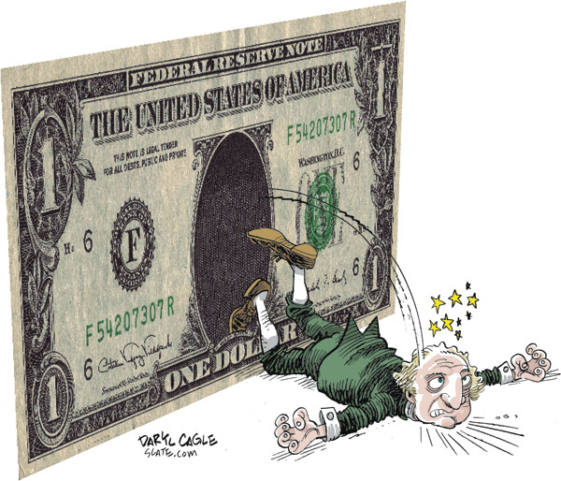
fiat
Anonymity
Bitcoin differs from traditional fiat currency for several reasons: it is not backed or governed by a central agency,

Slide 8
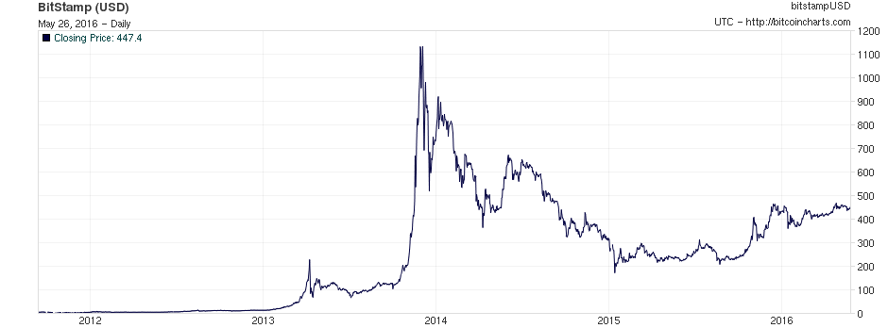
Historical BTC Prices
The Price of BTC (All Time)
Source: http://bitcoincharts.com/charts/bitstampUSD#tgCzm1g10zm2g25

Slide 9
Research Objective
Is BTC speculative investment or currency of the future. In other words, does it have political and economic capacity….

Slide 10

Literature Review
Kristoufek (2013)
Model demand through search queries
Capture investor sentiment
Yermack (2013)
Currency or speculation?
Efthymiou and Michael (2013)
Cypriot bank run
March 2013
De Long, et al. (1990)
Presence of noise traders
Drive up risk and returns

Slide 11
Yermack (2013)
Currency or speculation?
Money: functions as a medium of exchange, unit of account, and store of value.
Bitcoin performs poorly as a unit of account and as a store of value because of its high volatility (p. 2).
value is untethered to other currencies,
poor tool for risk management.
primary clientele:
technology enthusiasts who see the currency taking a prominent role in online commerce
libertarians wanting decentralized currency.
For Bitcoin to be accepted as currency, its value will have to stabilize.

Slide 12
Yermack (2013)
Currency or speculation?
Zohar (2015) rejoins this critique by suggesting that the confidence of this currency is gaining more traction over time as noted by the development of BitLicense by the New York State Department of Financial Services.
Moreover, no currency is perfect, so BTC does not need to be so.

Slide 13
Kristoufek (2013)
Model demand through search queries
Capture investor sentiment
Using Google and Wikipedia data on Bitcoin search queries, Kristoufek finds that the price of Bitcoin is strongly correlated with the search queries of both engines.
“The demand side of the market is not driven by an expected macroeconomic development of the underlying economy (as there is none); it is driven only by expected profits of holding the currency and selling it later”

Slide 14
Kristoufek (2013)
Model demand through search queries
Capture investor sentiment
Our research on EBSCOHOST points to the opposite.
YEAR | TITLE
2010 | 0
2011 | 32
2012 | 615
2013 | 1996
2014 | 2080
2015 | 841
2016 | 164

Slide 15
Efthymiou and Michael (2013)
Cypriot bank run
March 2013
POLITICAL AND ECONOMIC FACTORS
the Cypriot banking crisis is an example mistrust in traditional banks and currency
presented Bitcoin as an alternative medium.
In addition, the first dramatic boom and crash in April 2013 suggests that the Cypriot crisis may have acted as an important catalyst in Bitcoin’s popularity.
To determine the significance of this political event, a dummy variable will be incorporated into the model in this research.

Slide 16
De Long, et al. (1990)
Presence of noise traders
Drive up risk and returns
A noise trader OR idiot trader[ is a stock trader whose decisions to buy, sell, or hold are irrational and erratic - investment decisions based on perceived market movements rather than a security's fundamentals.
buys when everyone buys
sells when everyone selling
noise traders can cause prices and risk levels to diverge from expected levels even if all other traders are rational.

Slide 17
The 451 Dollar Question Is…
What activities drive the price of Bitcoin?

Slide 18
Variables: Investor Sentiment
VIX CNY
S&P Volatility Index
Shanghai Stock Exchange 380

Slide 19
Variables: BTC Economy
Google Trends Index
Total BTCs in Circulation
QUER SBTC
PLTC VOL
Price of Litecoin
Calculated Volatility

Slide 20
Variables: Dummies
DCYP DNEWS
Cypriot Bank Run
Headline Dates on Google Trends

Slide 21
Variables: Dummies
Correlation matrix

Slide 22

Methodology : Cointegration
Murray (1994)
Drunk and Her Dog

Slide 23
Model Specification
Short-Run Error-Correction Model
Long-Run Elasticities

Slide 24
Results: Long-Run Elasticities
2012-2013 Long-Run Elasticities

Slide 25
Results: Short-Run ECM
2012-2013 Short-Run Error-Corrected Summary Results
Indicates lagged variables

Slide 26


Dx: Under the Hood of the ECM
Wald………………………………….existence of cointegration
Breusch-Godfrey……………….serial autocorrelation
Jarque-Bera……………………….normality, skewness, and kurtosis
Augmented Dickey-Fuller….presence of unit root

Slide 27
Interpreting the Cointegrated Model
Variable | Sign (short/long) |  | Significance (short/long)
PBTC | - (unexp) | n/a | ***
VIX | + (exp) | - (unexp)
CNY | + (exp) | + (exp) | * | **
QUER | + (exp) | + (exp) |  | ***
PLTC | + (exp) | + (exp) | *** | ***
SBTC | - (unexp) | + (exp) | • | ***
VOL | + (exp) | + (exp) |  | ***
D1 | + (exp) | - (unexp) |  | ***
D2 | - (unexp) | + (exp)

Slide 28
What Does This Mean for BTC?
Structural, not predictive
Digital currency = unconventional indicators
Speculative investment vs. currency
Influence of irrationality, overconfidence, and animal spirits or something more?

Slide 29
Future Research
Bitcoin
Economic Models
Bitcoin protocol
Widespread adoption as currency
Bitcoin licensing and taxation
irrelevant variables
Hedge against political and economy instability

Slide 30
Bibliography
Bitcoin charts. (2014, Feb 06). Retrieved from http://bitcoincharts.com/charts/bitstampUSD
De Long, J. B., Shleifer, A., Summers, L. H., & Waldmann, R. J. (1990). Noise Trader Risk in Financial Markets. Journal of Political Economy, 98(4), 703-738.
Efthymiou, L., & Michael, S. (2013). When Cards and ATM’s are the only choice: A fortnight in Cyprus with no banking system, nor trust.
Kristoufek, L. (2013). BitCoin meets Google Trends and Wikipedia: Quantifying the relationship between phenomena of the Internet era. Scientific reports, 3.
Yermack, D. (2013). Is Bitcoin a Real Currency? (No. w19747). National Bureau of Economic Research.

Slide 31
Questions & Answers

